Slide 1
Apache pyspark

Slide 2
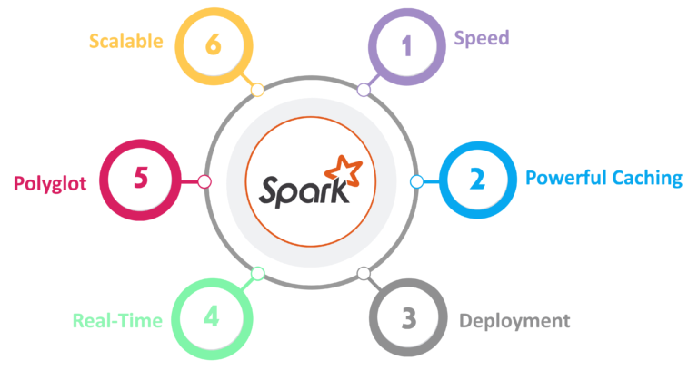
Features of Pyspark

Slide 3
Spark Architecture
Apache Spark has a well-defined layered architecture where all the spark components and layers are loosely coupled. This architecture is further integrated with various extensions and libraries.Apache Spark Architecture is based on two main abstractions:
Resilient Distributed Dataset (RDD)
Directed Acyclic Graph (DAG)

Slide 4
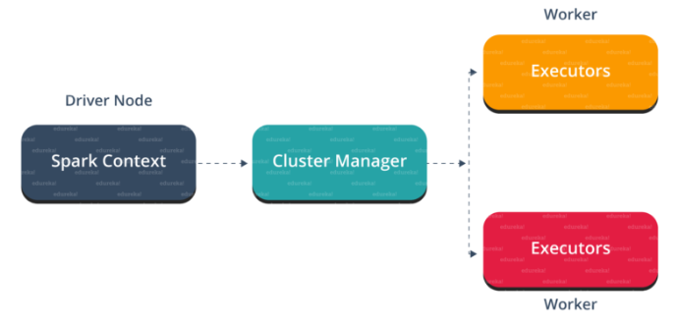
Master Slave Architecture

Slide 5
Workflow of the Spark Architecture
In your master node, you have the driver program, which drives your application. The code you are writing behaves as a driver program or if you are using the interactive shell, the shell acts as the driver program. Inside the driver program, the first thing you do is, you create a Spark Context. Assume that the Spark context is a gateway to all the Spark functionalities. It is similar to your database connection. Any command you execute in your database goes through the database connection. Likewise, anything you do on Spark goes through Spark context.
Now, this Spark context works with the cluster manager to manage various jobs. The driver program & Spark context takes care of the job execution within the cluster. A job is split into multiple tasks which are distributed over the worker node. Anytime an RDD is created in Spark context, it can be distributed across various nodes and can be cached there.
Worker nodes are the slave nodes whose job is to basically execute the tasks. These tasks are then executed on the partitioned RDDs in the worker node and hence returns back the result to the Spark Context.

Slide 6
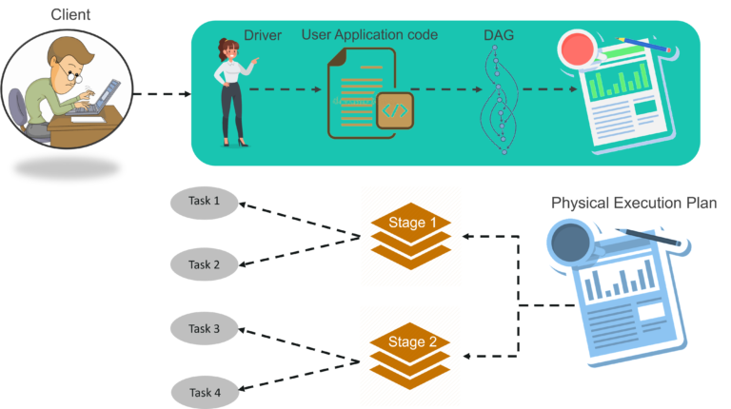
Stepwise workflow

Slide 7
STEP 1: The client submits spark user application code. When an application code is submitted, the driver implicitly converts user code that contains transformations and actions into a logically directed acyclic graph called DAG. At this stage, it also performs optimizations such as pipelining transformations.
STEP 2: After that, it converts the logical graph called DAG into physical execution plan with many stages. After converting into a physical execution plan, it creates physical execution units called tasks under each stage. Then the tasks are bundled and sent to the cluster.

Slide 8
STEP 3: Now the driver talks to the cluster manager and negotiates the resources. Cluster manager launches executors in worker nodes on behalf of the driver. At this point, the driver will send the tasks to the executors based on data placement. When executors start, they register themselves with drivers. So, the driver will have a complete view of executors that are executing the task.
STEP 4: During the course of execution of tasks, driver program will monitor the set of executors that runs. Driver node also schedules future tasks based on data placement.

Slide 9
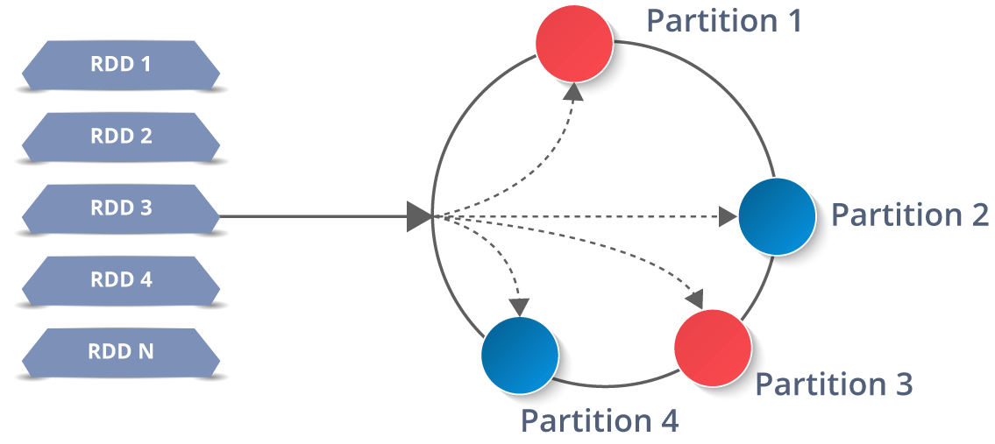
Resilient Distributed Database
RDDs are the building blocks of any Spark application. RDDs Stands for:
Resilient: Fault tolerant and is capable of rebuilding data on failure
Distributed: Distributed data among the multiple nodes in a cluster
Dataset: Collection of partitioned data with values

Slide 10
The data in an RDD is split into chunks based on a key. RDDs are highly resilient, i.e, they are able to recover quickly from any issues as the same data chunks are replicated across multiple executor nodes. Thus, even if one executor node fails, another will still process the data. This allows you to perform your functional calculations against your dataset very quickly by harnessing the power of multiple nodes.

Slide 11
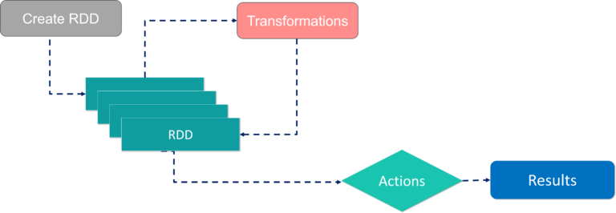
With RDDs, you can perform two types of operations:
Transformations: They are the operations that are applied to create a new RDD.
Actions: They are applied on an RDD to instruct Apache Spark to apply computation and pass the result back to the driver.

Slide 12
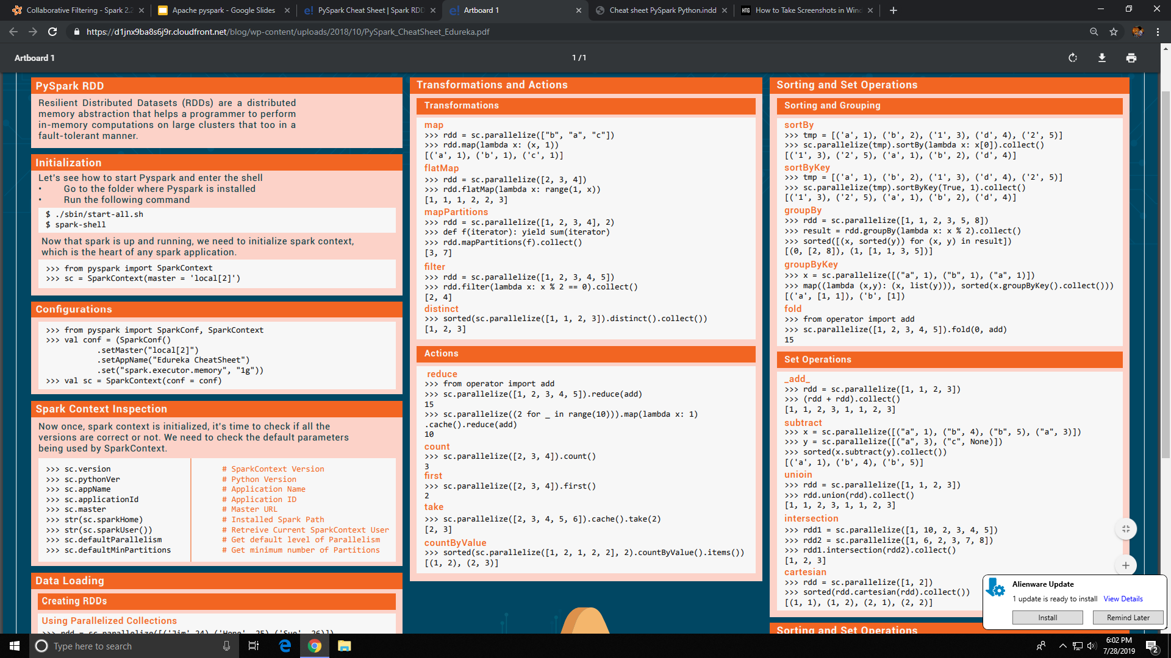

Slide 13
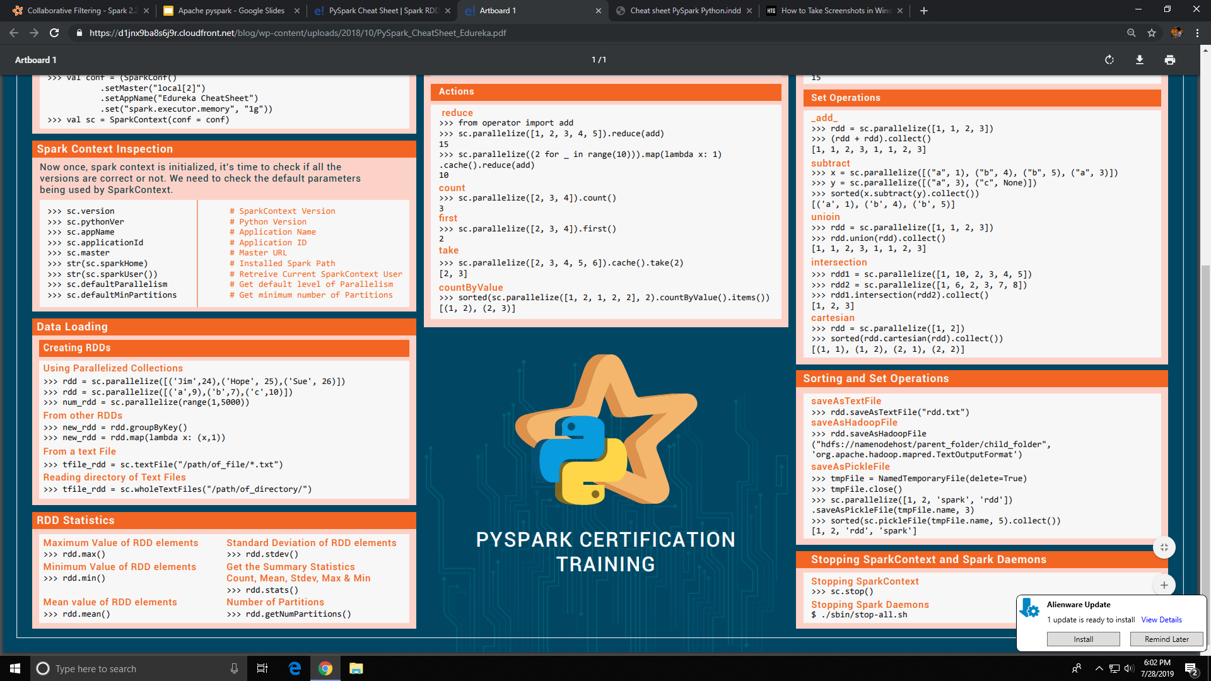

Slide 18
from pyspark import SparkConf, SparkContext
conf = SparkConf().setMaster("local").setAppName("FriendsByAge")
sc = SparkContext(conf = conf)
def parseLine(line):
fields = line.split(',')
age = int(fields[2])
numFriends = int(fields[3])
return (age, numFriends)
0, Will, 33, 385
1, Jean-Luc, 26, 2
2, Hugh, 55, 221
3, Deanna, 40, 465
4, Quark, 68, 21
5, Weyoun, 59, 318
6, Gowron, 37, 220

Slide 19
lines = sc.textFile("file:///SparkCourse/fakefriends.csv")
rdd = lines.map(parseLine)
totalsByAge = rdd.mapValues(lambda x: (x, 1)).reduceByKey(lambda x, y: (x[0] + y[0], x[1] + y[1]))
averagesByAge = totalsByAge.mapValues(lambda x: x[0] / x[1])
results = averagesByAge.collect()
for result in results:
print(result)

Slide 20
from pyspark import SparkConf, SparkContext
conf = SparkConf().setMaster("local").setAppName("MinTemperatures")
sc = SparkContext(conf = conf)
def parseLine(line):
fields = line.split(',')
stationID = fields[0]
entryType = fields[2]
temperature = float(fields[3]) * 0.1 * (9.0 / 5.0) + 32.0
return (stationID, entryType, temperature)
ITE00100554,18000101,TMAX,-75,,,E,
ITE00100554,18000101,TMIN,-148,,,E,
GM000010962,18000101,PRCP,0,,,E,
EZE00100082,18000101,TMAX,-86,,,E,
EZE00100082,18000101,TMIN,-135,,,E,

Slide 21
lines = sc.textFile("file:///SparkCourse/1800.csv")
parsedLines = lines.map(parseLine)
minTemps = parsedLines.filter(lambda x: "TMIN" in x[1])
stationTemps = minTemps.map(lambda x: (x[0], x[2]))
minTemps = stationTemps.reduceByKey(lambda x, y: min(x,y))
results = minTemps.collect();
for result in results:
print(result[0] + "\t{:.2f}F".format(result[1]))

Slide 22
import re
from pyspark import SparkConf, SparkContext
def normalizeWords(text):
return re.compile(r'\W+', re.UNICODE).split(text.lower())
conf = SparkConf().setMaster("local").setAppName("WordCount")
sc = SparkContext(conf = conf)
input = sc.textFile("file:///sparkcourse/book.txt")
words = input.flatMap(normalizeWords)
This book tells you how I improved my life by quitting my job, and creating a sustainable and growing income through self-employment. What I learned along the way could help you do the same.
But no matter how much advice or how many stories I give you, in the end success relies on your own preparation

Slide 23
wordCounts = words.map(lambda x: (x, 1)).reduceByKey(lambda x, y: x + y)
wordCountsSorted = wordCounts.map(lambda x: (x[1], x[0])).sortByKey()
results = wordCountsSorted.collect()
for result in results:
count = str(result[0])
word = result[1].encode('ascii', 'ignore')
if (word):
print(word.decode() + ":\t\t" + count)

